Slide 1

DEPARTMENT OF COMPUTER SCIENCE & ENGINEERING ACHARYA INSTITUTE OF TECHNOLOGY
Internship Presentation on
“Predicting the price of used cars and bikes”
Presented by:
Rachana JM (1AY17CS069)
Under the guidance of:
Prof. Vani K S
Assistant Professor

Slide 2
1.
Agenda
Certificate
Abstract
About the industry
Training/ Technology
Software Design
Algorithm
Implementation
Results
Learning outcomes

Slide 3
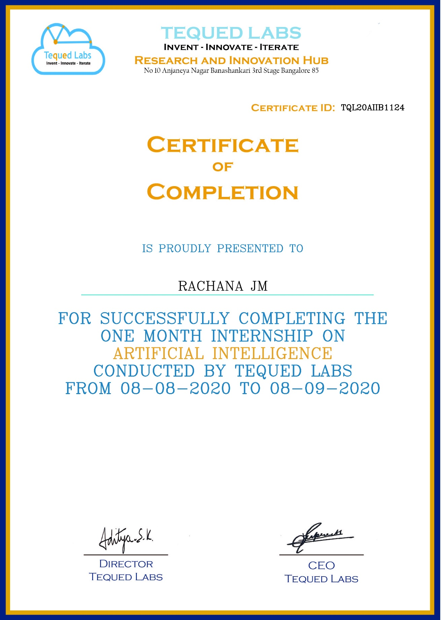
Certificate

Slide 4
Abstract
Determining whether the listed price of a used car is a challenging task, due to the many factors.
The focus of my internship project is to develop a machine learning model that can accurately predict the price of a used car based on its features.
To develop the project we have used multiple linear regression analysis along with the dataset from Kaggle.
The predictions are then evaluated and compared in order to find those which provide the best performances.

Slide 5

About the industry
Tequed labs is an Innovation and research hub based in Bangalore. It is focused on providing quality education to students regarding the various latest technologies developing all over the world everyday.
It also focuses on creating innovative products to the society and also mentors various potential startups and ideas

Slide 6
Training/Technology used
Machine Learning
Machine learning (ML) is the study of computer algorithms that improve automatically through experience and by the use of data and it is seen as a part of artificial intelligence.
Python Programming Language
Python is an interpreted high-level general-purpose programming language. Python's design philosophy emphasizes code readability with its notable use of significant indentation.
Linear Regression
Linear Regression, is a method of modelling a target value based on independent predictors. This method is mostly used for forecasting and finding out the cause and effect relationship between variables.

Slide 7
Software Design
Dataset
For this project, we are using the dataset on used car and bikes sales available on Kaggle website. The features available in this dataset are name of the vehicle, vehicle type, year, odometer, fuel, owner, selling price.

Slide 8
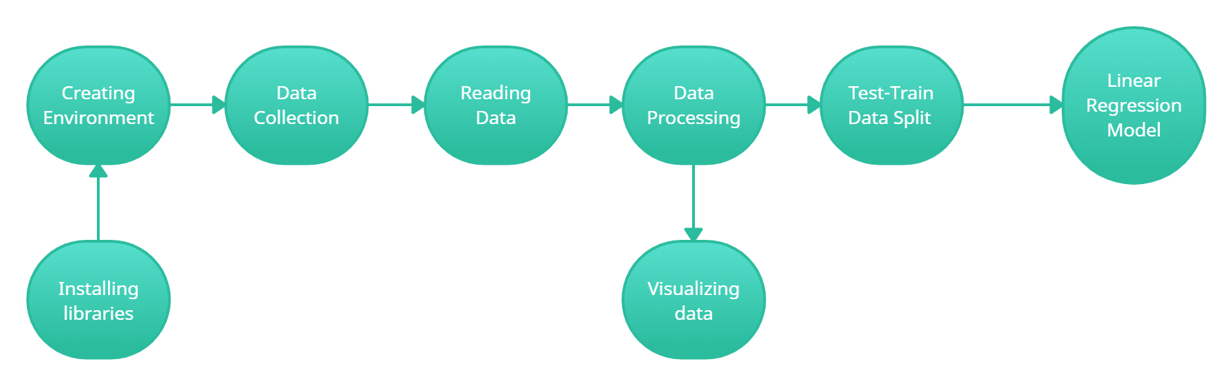
Software Design
Methodology
The workflow of the machine learning model includes the following steps:

Slide 9
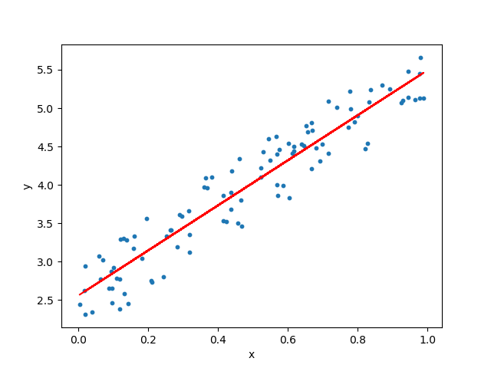
Software Design
Model Design
Linear regression is a type of regression analysis
where the number of independent variables is one
and there is a linear relationship between the
independent(x) and dependent(y) variable.
The red line in the above graph is referred to as the
best fit straight line. Based on the given data points, we try to plot a line that models the points the best.

Slide 10
Algorithm
Algorithm Used
Linear regression is the algorithm employed to find out the extent up to which there is a linear relationship between some dependent and one or more independent variables.
Regression techniques mostly differ based on the number of independent variables and the type of relationship between the independent and dependent variables.

Slide 11
Algorithm
Step 1: Reading and Understanding data:
The dataset on used car and bikes sales are collected from Kaggle.
The file can be saved in any of the formats (like csv, pdf, excel, txt etc).
Step 2: Importing Packages:
Importing data using the pandas library.
Understanding the structure of the data
Step 3: Testing the data:
To look at the data types to see which columns need to be encoded.
Step 4: Splitting the data:
To Split the dataset into independent(X) and dependent(Y) datasets.
Step 5: Building Regular Expression:
This is the most important step. According to the data, Regular Expression need to be constructed properly.

Slide 12
Implementation
Load libraries
Load Data.
Data Inspection.
Data Visualization.
Creating dummies for categorical value.
Split the data into training and testing sets.
Train the model using Linear Regression.
Calculating the mean squared error and the model accuracy.

Slide 13
8.
Results

Slide 14
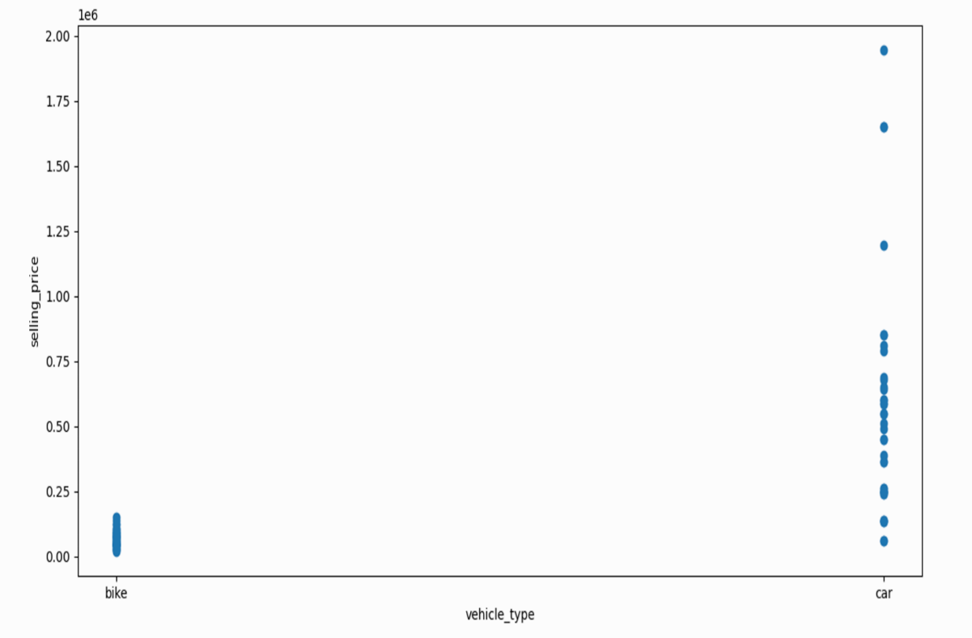
Graph against vehicle type versus price

Slide 15
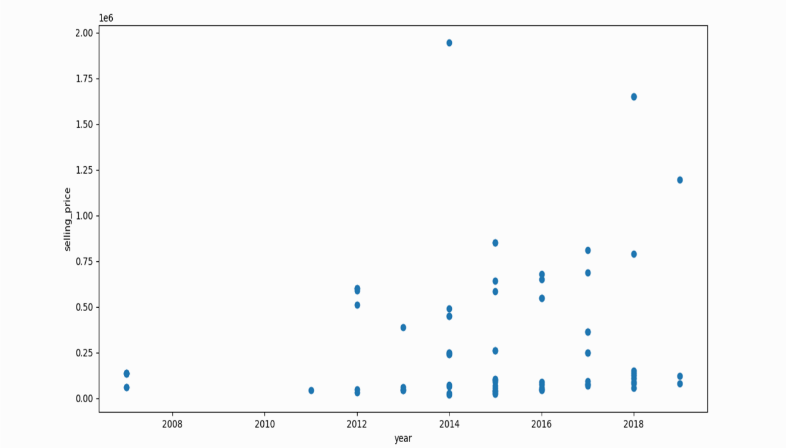
Graph against manufacturing year versus price

Slide 16
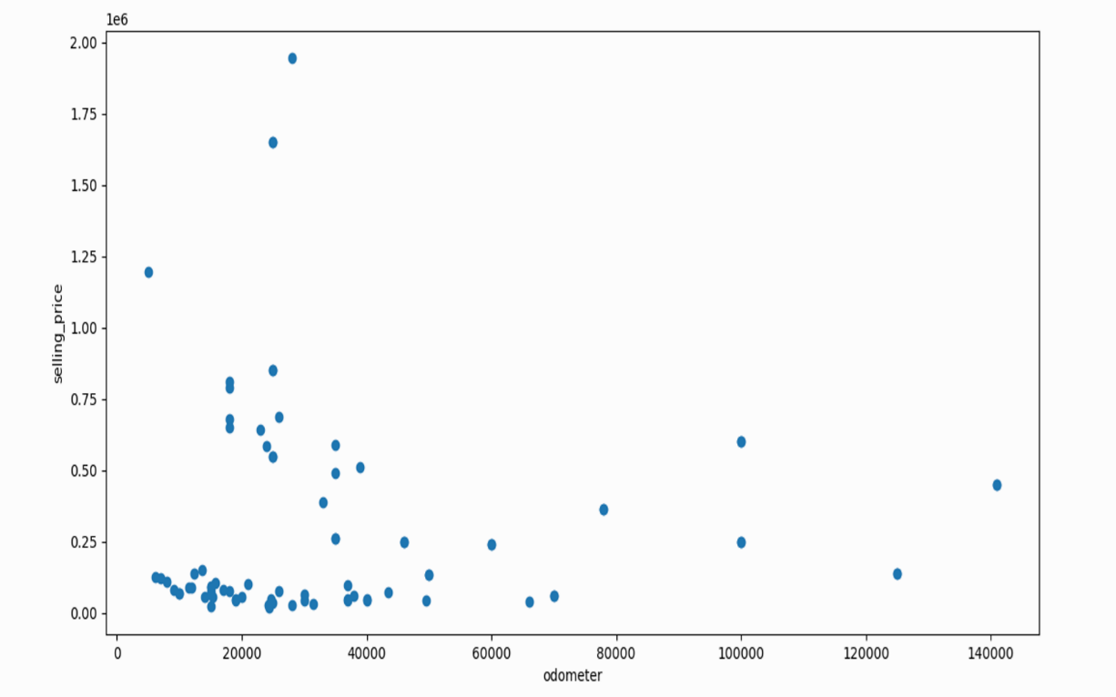
Graph against odometer versus price

Slide 17
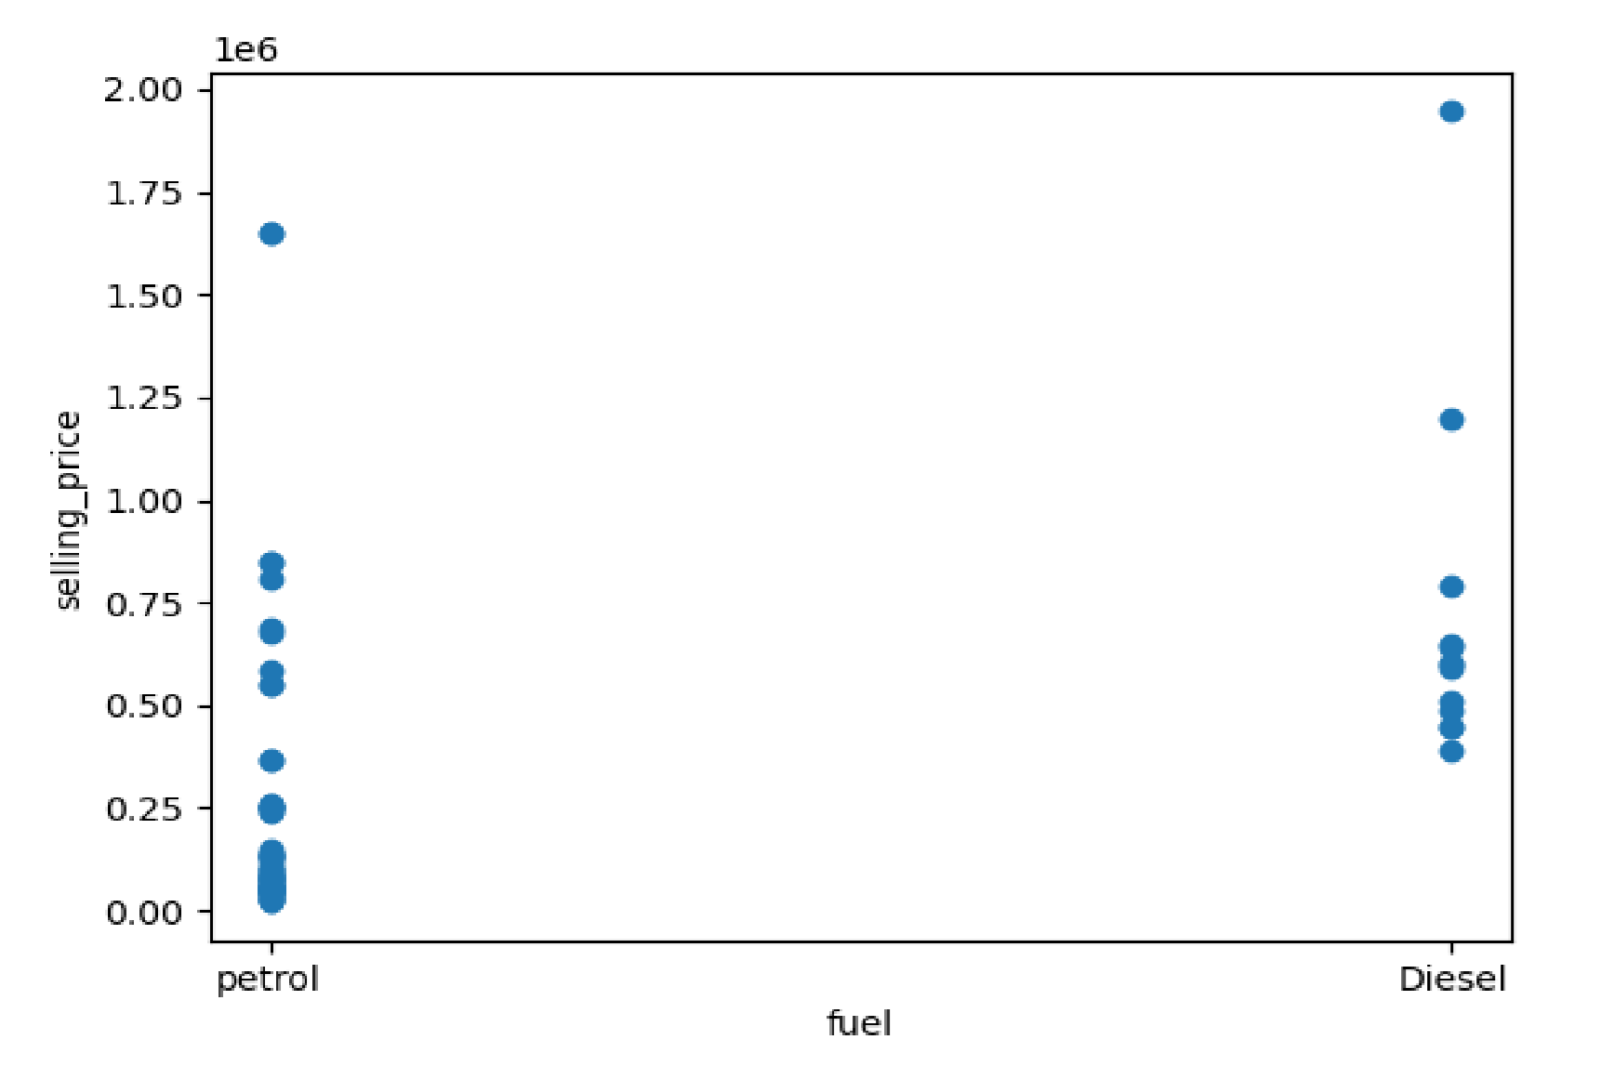
Graph against fuel type versus price

Slide 18
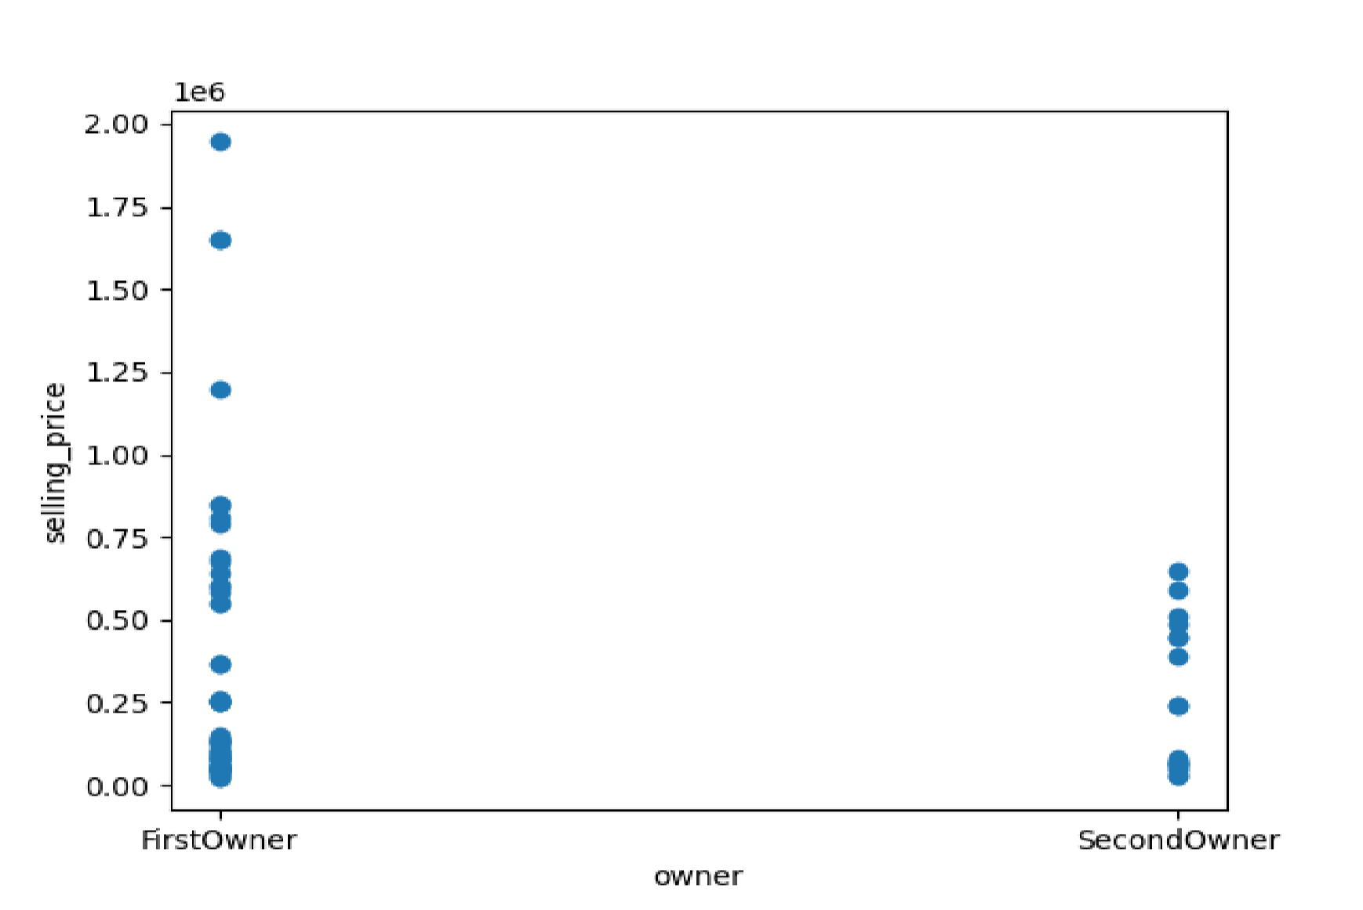
Graph against owner versus price

Slide 19
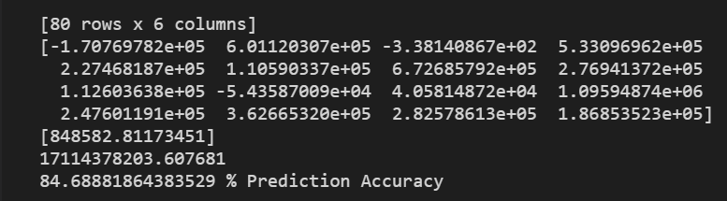
The mean squared error and model accuracy
This shows the model accuracy of Linear Regression is 0.84 which is good and predictions were quite close to the original selling prices.

Slide 20
Learning Outcomes
A different exposure to the advanced technologies used in industry.
Learnt how to build regular expression and how it is useful in real time.
Understood how necessary and important to know the price of the vehicle we buy today would be tomorrow.
Learn skills regarding paper publishing including reading blogs, research papers etc.

Slide 21
Stipend
This was an unpaid internship.

Slide 22
Thank you!
Any questions?

